Slide 1



SMART INDIA HACKATHON 2024
TITLE PAGE
Problem Statement ID – 1770
Problem Statement Title- Personalized testing kits for testing Bacteriological contamination at delivery points
Theme- Smart Automation
PS Category- Hardware
Team ID- 14627
Team Name (Registered on portal)- QUASARS

Slide 2

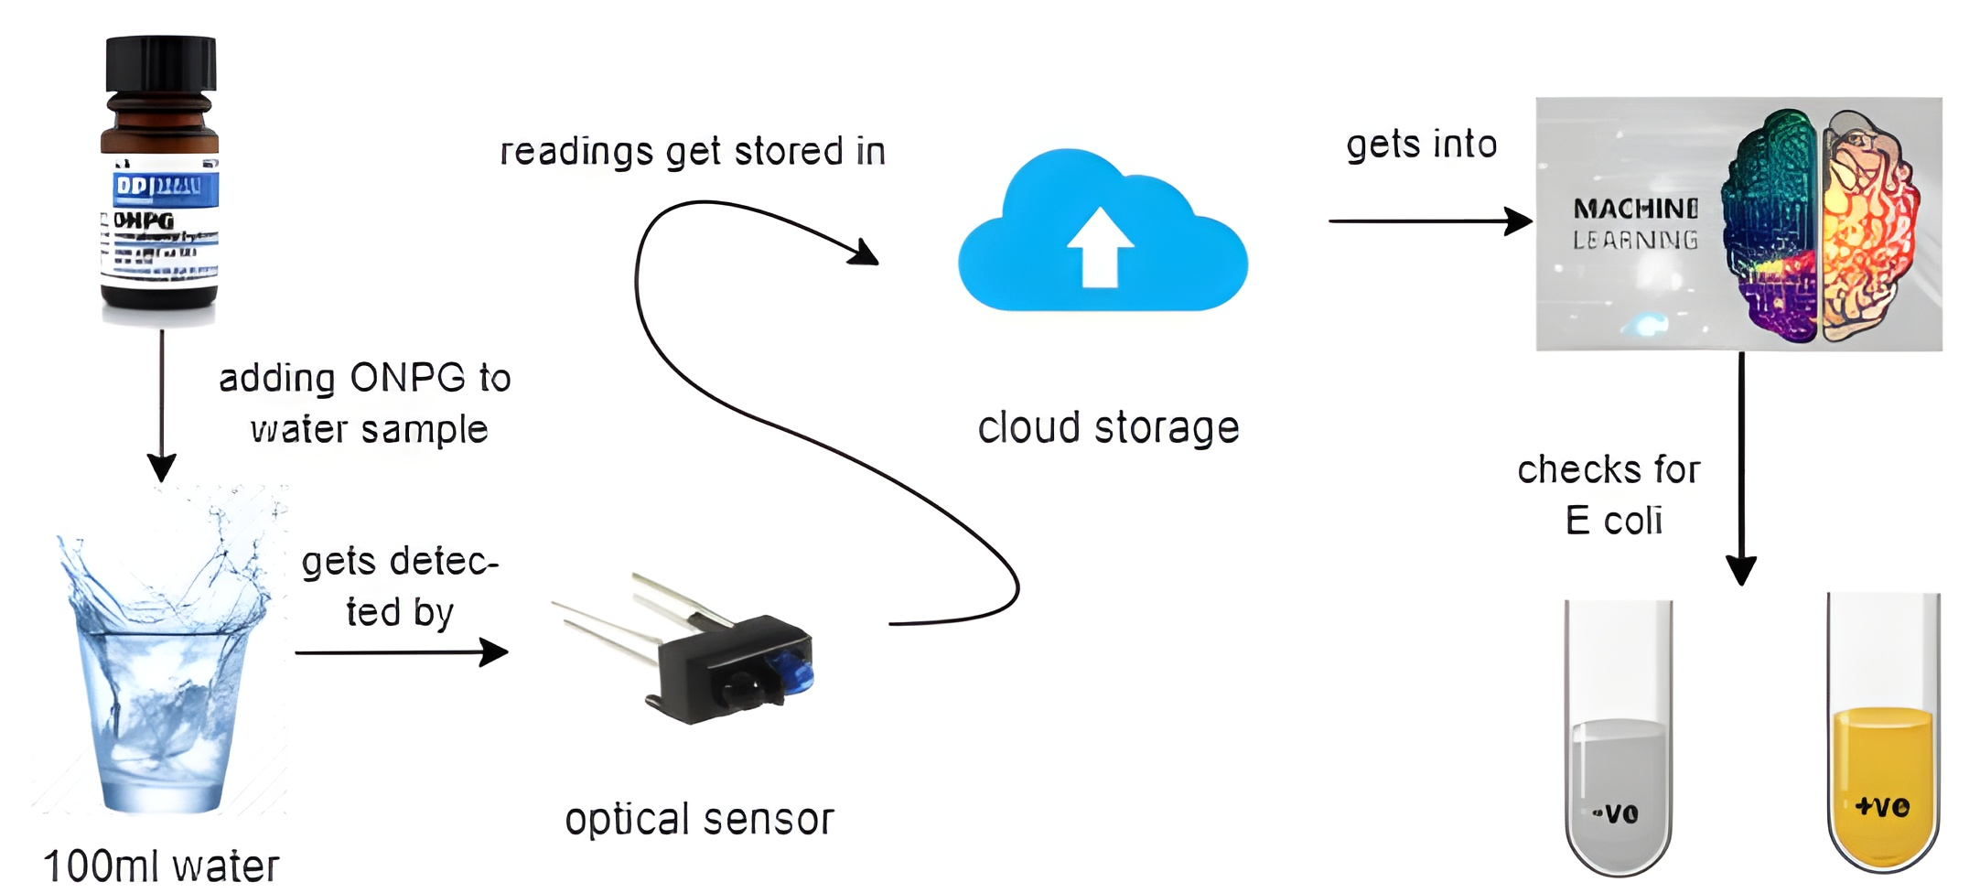
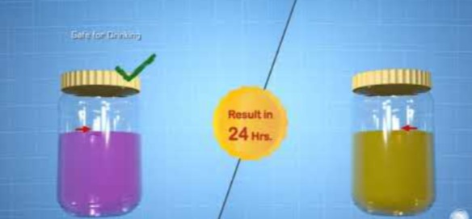
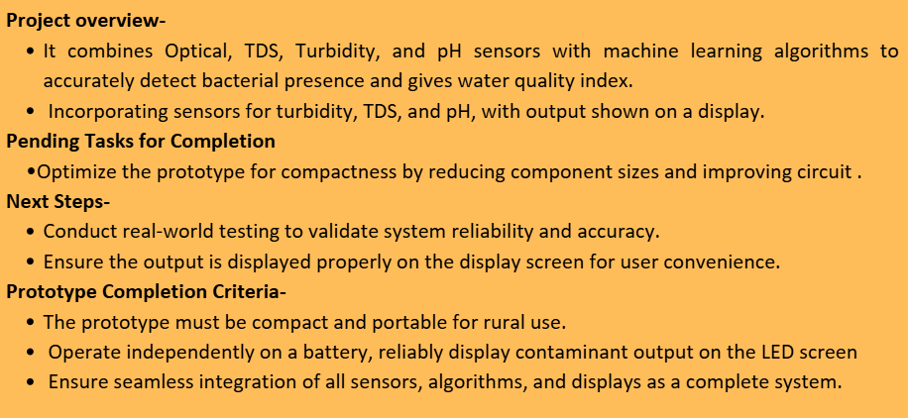
Personalized Water Testing Kit
PROPOSED SOLUTION
1)Detailed Explanation-
It combines Optical, TDS, Turbidity, and pH sensors with machine learning algorithms to accurately detect bacterial presence.
2)How it addresses the problem-
It integrates optical, TDS, Turbidity sensors to accurately detect bacteria
Delivers instant, accurate results for continuous water safety assurance
3)Uniqueness of the problem-
Combines multiple sensors for precise water quality analysis.
Portable, durable, and easy to use and long lasting.
@SIH Idea submission- Template
2

Slide 3
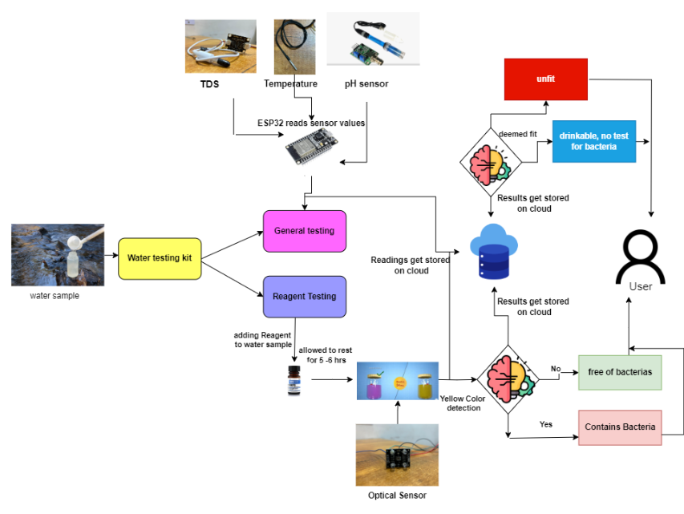
TECHNICAL APPROACH
Instant-Water Quality detection
With the help of sensors like TDS, turbidity ,Ph and Optical, gives us the idea about the quality of water
Bacterial Contamination
Upon reacting with reagent and followed by optical sensor helps detect presence of T coli and E coli bacteria.

Slide 4

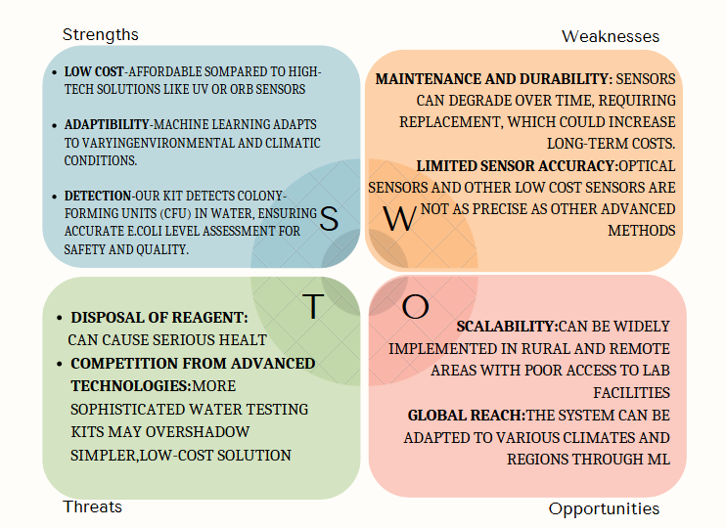

FEASIBILITY AND VIABILITY
Cost Analysis

Slide 5
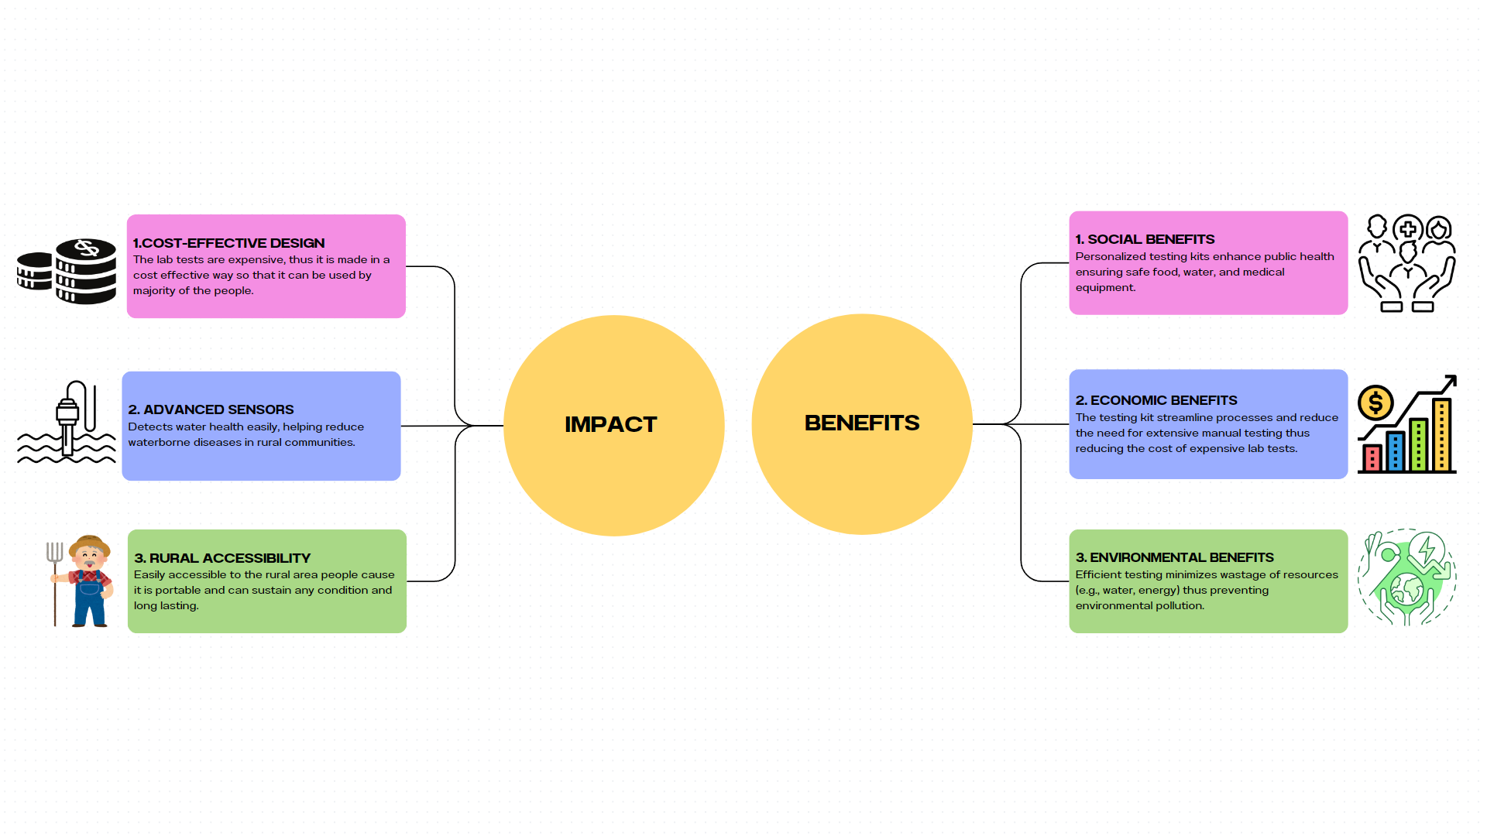
IMPACT AND BENEFITS

Slide 6
RESEARCH AND REFERENCES
- Traditional lab methods for E. coli are accurate but slow and inaccessible in rural areas.
- Optical sensors with reagents detect E. coli via colour change (yellow) after 12 hours.
- Multiple sensors (turbidity, gas, TDS, temperature) enable instant water checks.
Machine learning enhances accuracy by adapting to different climates.
Offers a cost-effective alternative to advanced tech like UV or ORB sensors.
Progress in methods for the detection of viable Escherichia coli
E. coli Detection Using Colorimetric Sensors:
Nguyen, T., Kim, Y., & Song, S. (2020). Development of a colorimetric sensor using gold nanoparticles to detect Escherichia coli rapidly. Journal of Nanoscience and Nanotechnology, 20(12), 7617-7622.
DOI: 10.1166/jnn.2020.18589
Link : https://www.ncbi.nlm.nih.gov/pmc/articles/PMC5587108/
Molecular testing devices for on-site detection of E. coli in water samples
Carlos Manzanas, Elise Morrison, Young S. Kim, Morteza Alipanah, George Adedokun, Shouguang Jin, Todd Z. Osborne & Z. Hugh Fan
Link: https://www.nature.com/articles/s41598-023-31208-4

